Slide 1
Analyzing Network Traffic for Designing Better Intrusion Detection System
Project Supervisor
Dr.Chokkalingam
Head of Department(CSE)
P. Venkata Sai
191511063
IV CSE

Slide 2
Design

Slide 3
The traffic between the computers in a network and the internet
Analysing with VirusTotal, Shodan API’s and WHOIS
Log report to the server and localhost with web interface
Network traffic
Capturing packets
Static trails /API’s
Filtering and Blocking
Log report to server
Capturing the packets using PCAP from the network
Filtering based on the results from API’s

Slide 4
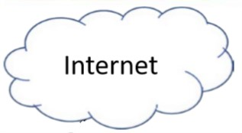
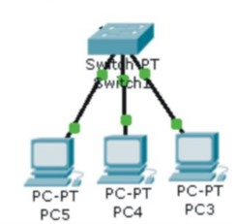
Architecture
Sensor script
Server script

Slide 5
Implementation

Slide 6
Sensor
“Sensor” is an algorithm designed to capture the packet from the inbound direction in the core routers
This is basically using concept of “PORT MIRRORING” using PCAP
It Defragments the packet to src_ip, dst_ip, src_port, dst_port, domain_name, query (if exist) and protocol used

Slide 7
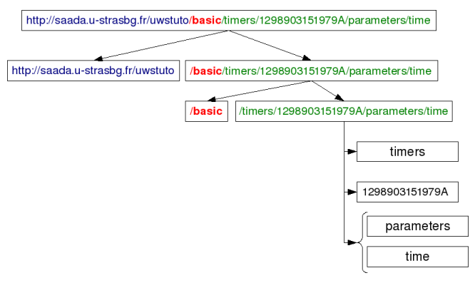
URL splitting

Slide 8
Sensor working
Step : 1
The internet traffic is being mirrored to the sensor for analyzing using pcap
Sensor

Slide 9
Sensor working
Step : 2
Blacklists
Sensor
The captured packet data (src_ip, dst_ip, src_port, dst_port, domain_name, query ) is sent to the blacklists and white lists
Whitelists

Slide 10
Sensor working
Step : 2
Blacklists
TRUE
Sensor
If the results from the blacklists is true then the traffic is BLOCKED and DROPPED
Whitelists

Slide 11
Sensor working
Step : 2
Blacklists
Sensor
If the results from the blacklists is true then the traffic is ALLOWED
TRUE
Whitelists

Slide 12
Sensor working
Step : 2
Blacklists
UNDEFINED
Sensor
If the results from the blacklists UNDEFINED then this is sent to API’s
UNDEFINED
Whitelists

Slide 13
Sensor working
Step : 2
Sensor
VirusTotal Shodan
The same data is sent to API’s

Slide 14
Sensor working
Step : 2
Sensor
VirusTotal Shodan
POSITIVE
If the results from the blacklists is true then the traffic is BLOCKED and DROPPED

Slide 15
Sensor working
Step : 2
Sensor
VirusTotal Shodan
NEGATIVE
The traffic is allowed to pass through

Slide 16
Server working
Step : 3
Sensor
The server DATA is sent to server if the result is POSITIVE
Server

Slide 17
Server working
It gets the analyzed details from the sensor(s) which have been configured in the core routers
The server will align the raw data for presenting to the user in pictorial form
The server may be in the internal network or external network
Here I’ve used my computer for configuring both sensor and server

Slide 18
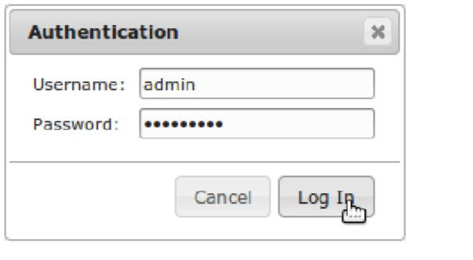
Log In screen for admin to monitor

Slide 19
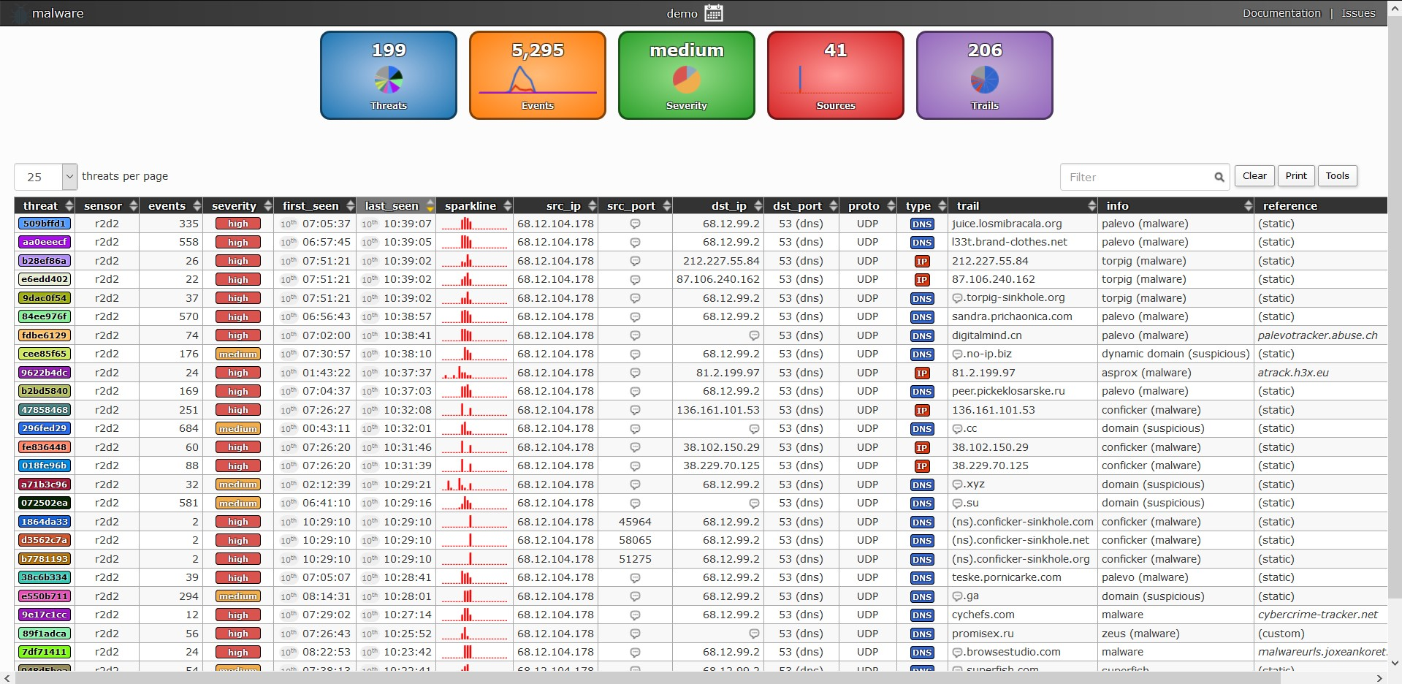
Server working
Server will create a log about the particular domain or the suspicious activity by blacklisted domains

Slide 20
Server working
The over all threat results are shown in the above slide with the detailed description like severity, last seen, source IP destination IP, Source port , destination port, Type, information

Slide 21
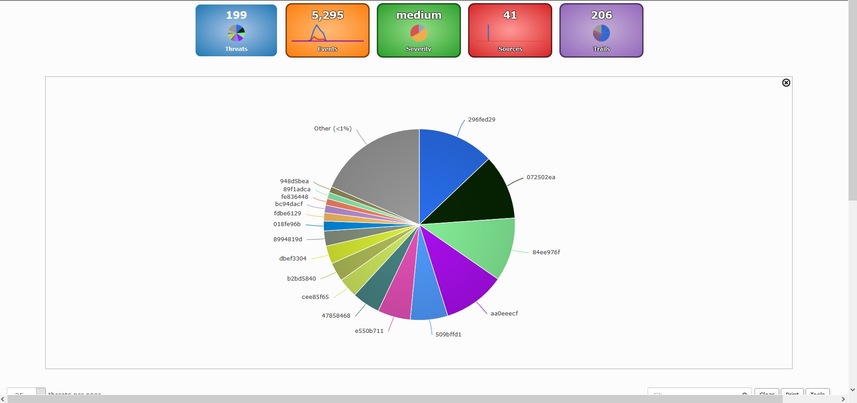
Overall Threat analysis

Slide 22
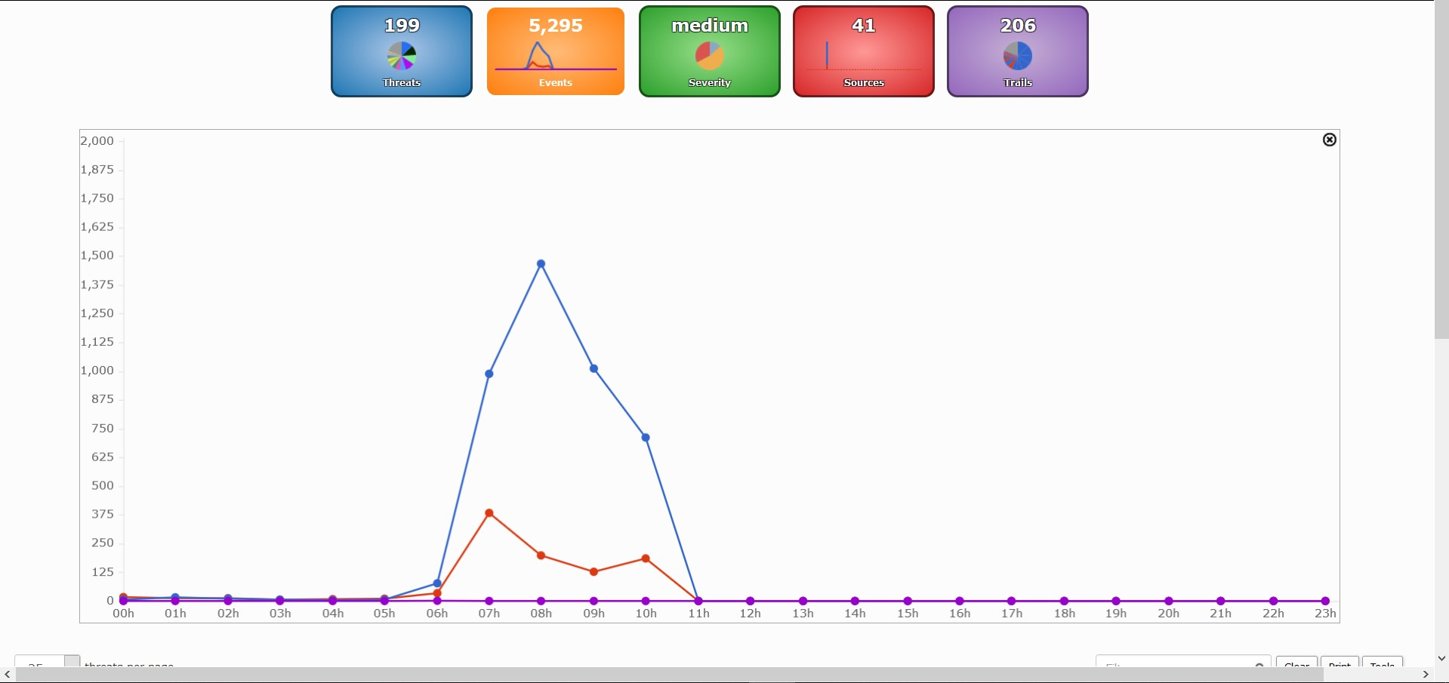
Graph showing the Events

Slide 23
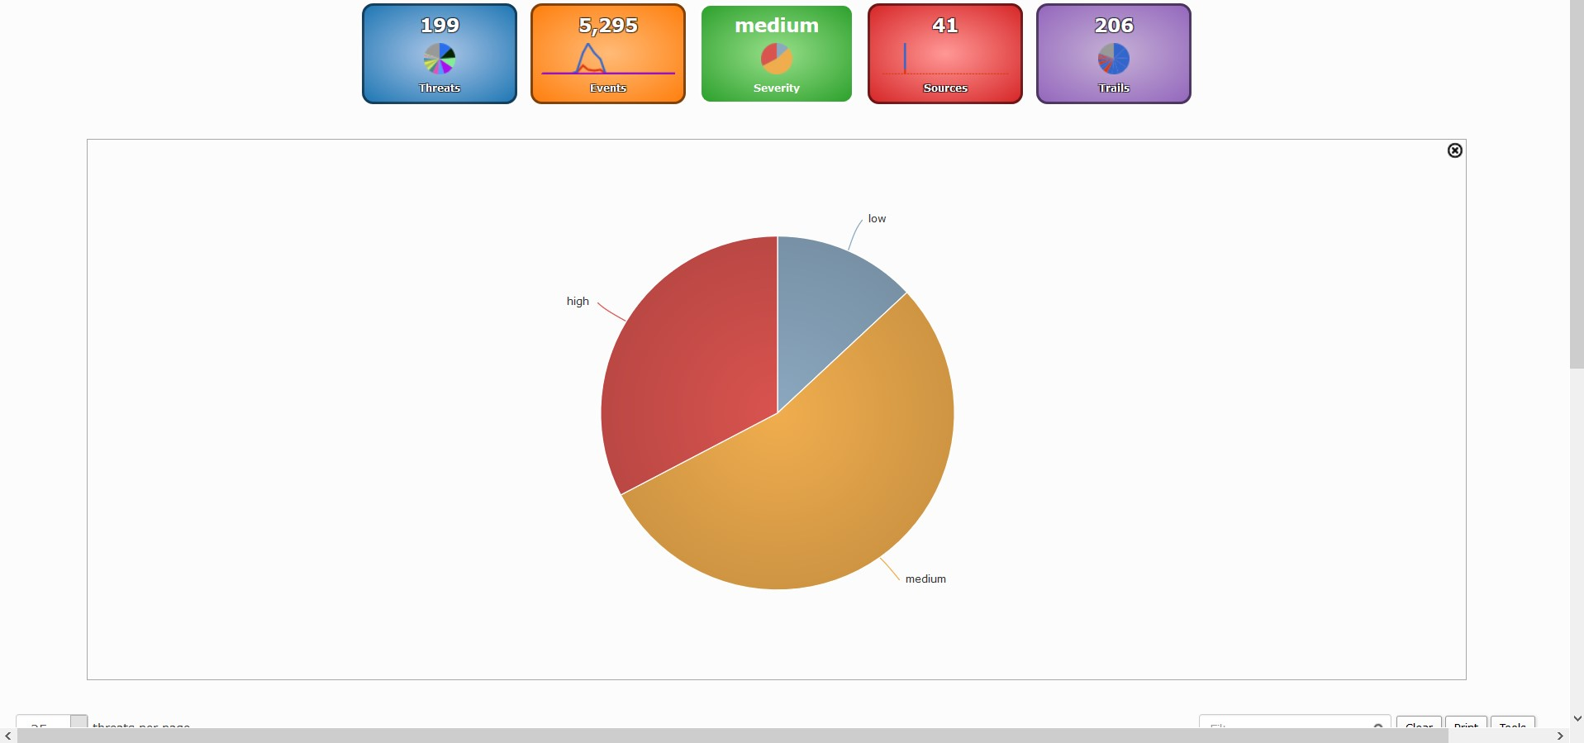
Chart showing severity of traffic

Slide 24
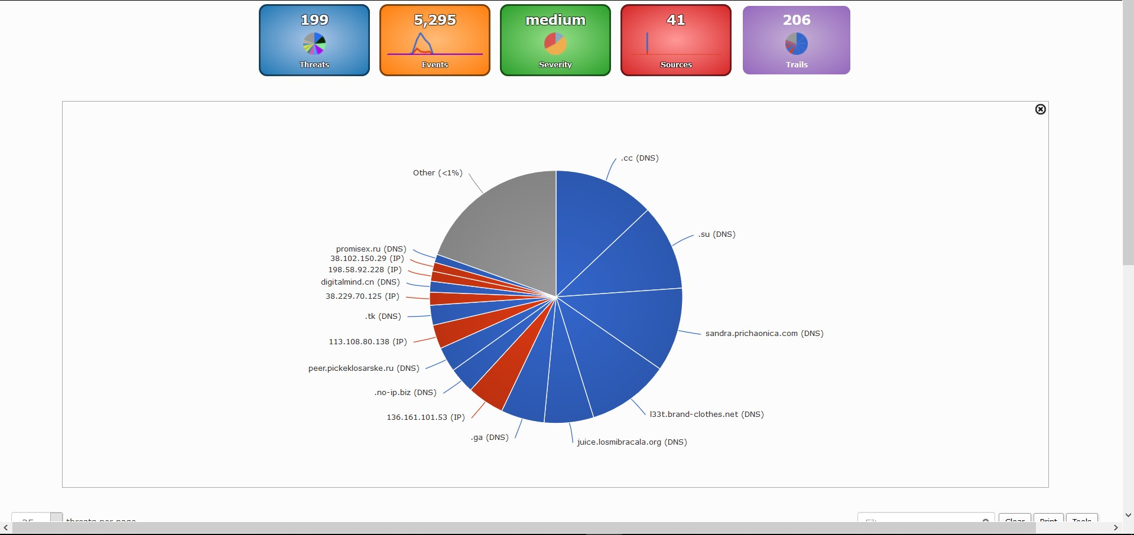
Chart showing Trails of traffic

Slide 25
Demo

Slide 26
Server updating it’s definitions

Slide 27


Slide 28
Server and sensor running

Slide 30
Admin log in

Slide 31


